Slide 1
Introduction Operating System Operating System Zoo

Slide 2
Objectives
Operating System (OS)
The Operating System Zoo
Mainframe OS
Server OS
Multiprocessor OS
PC OS
Handheld Computer OS
Embedded OS
Sensor Node OS
Real-Time OS
Smart Card OS

Slide 3
Operating System
Context
Why do we install the Windows, or Linux, or Unix, or Macs, etc …, that is called Operating System (OS), before we want to use and control/ manipulate our computer (laptop or desktop or mobile or other devices)?
How do we manipulate the computer hardware (RAM, Disks, AGP card, Audio card, Keyboard, touch screen, etc …)?
How can our computer run or execute many programs at the time without being worried finitely RAM, one or two CPU? Do they run in parallel or in sequence order? …
How can our computer allocate the computer’s device to many running programs at the time?
What’s the OS’s role in our computer? What’s it’s main functions? Which problems do we or our computer take without the absent OS? Is the OS software or hardware?
The big question is “What is the OS?”
The important questions are
Why do we learn OS?
What constraint do between OS and SE (both IS and ES)?

Slide 4
Overview
Operating System
A computer system consists of:
User software
System software
Hardware
User Applications | Compilers | Editors | Shells
Operating System
Hardware
User mode
Software
Kernel mode (supervisor mode)

Slide 5
Operating System
Definition
A system software that acts as an intermediary between user of a computer and the computer hardware
A collection of procedures that:
Manage all the system’s hardware resources
Provide the users the environment in which they can
Use the system resources
Run their own applications
Goals
Execute user programs (mostly for ease of use with performance)
Make the hardware efficiently and convenient to use
Controls and coordinates the use of hardware among the various application programs for various users
Hides the peculiarities of disks and I/O devices
Notes:
intermediary: trung gian
Peculiarities: đặc thù

Slide 6
Operating System
Terminologies
Kernel mode
Is also called supervisor mode
OS runs in this mode
Gains control of the computer
Has complete access to all the hardware
Can execute any machine instructions
Protects the OS from errant users
User mode
The user software runs in this mode
Can execute a subset of the machine instructions with the exception of instructions to control of the machine or do I/O
The system switches between the kernel mode and user mode
If the user interacts with OS, the user mode switches to the kernel mode
If the system passes control to a user program, the kernel mode switches to the user mode

Slide 7
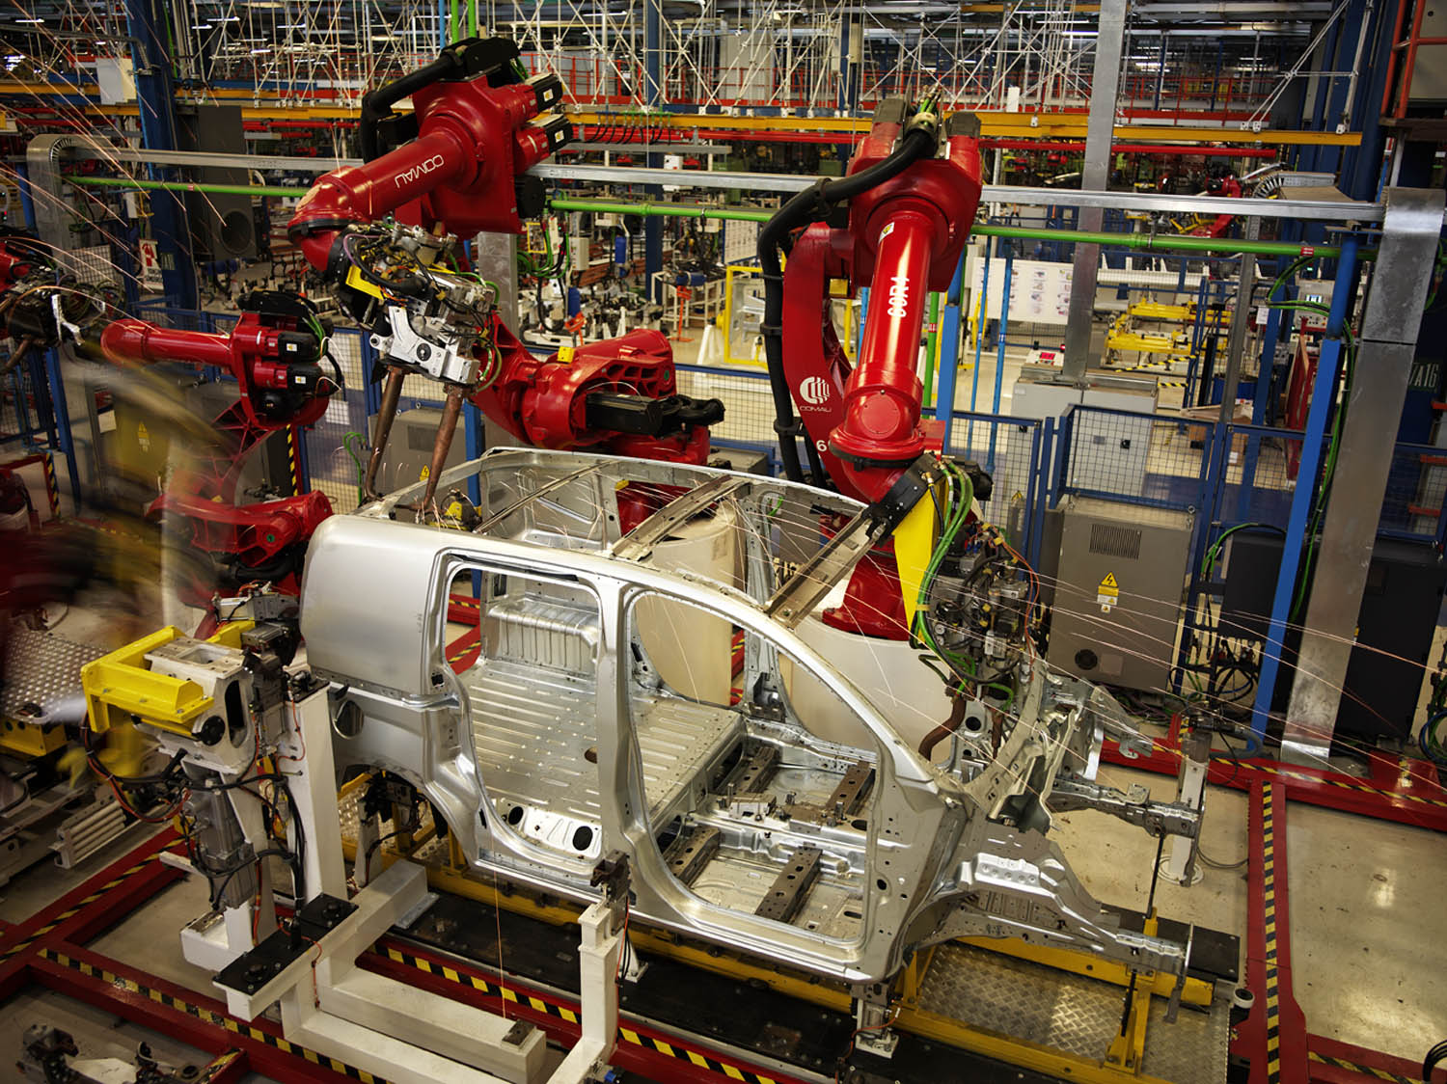
The Operating System Zoo
Mainframe OS
Are heavily oriented toward processing many jobs at once, most of which need prodigious amounts of I/O
Offers 3 kinds of services
Batch
Ex: car assembly lines
Runs one and only one application
Process routine job without interactive user present
The OS always resides in memory and transfer control automatically from one job to the next in the sequence requested jobs
CPU is often idle, all jobs are kept on a disk
Notes:
3 kinds of mainframe OS:
+ Batch
+ Transaction processing
+ Time-sharing

Slide 8
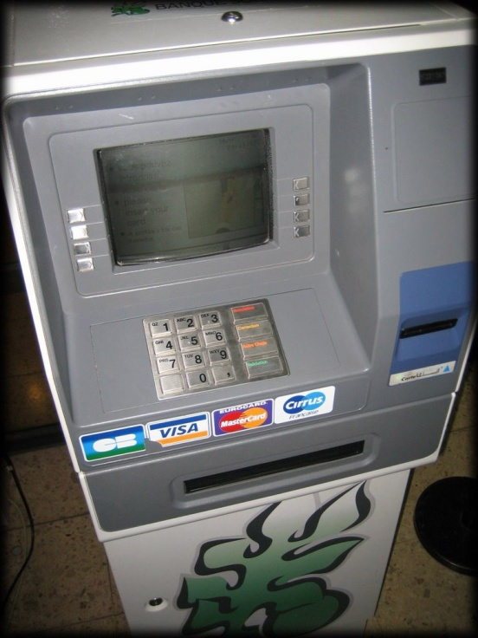
The Operating System Zoo
Mainframe OS
Transaction processing
Ex: ATM banking
Handle large numbers of small requests
A single unit of work that consists of one or more operations that are interconnected
Series of operations are All or None
Timesharing (multitasking)
Ex: Google Search Server (Interactive System)
Allow multiple remote users to run jobs on the computer at once
Each user has at least one separate program in memory
OS/390 and OS/360, then they’re gradually being replaced by UNIX variants such as Linux

Slide 9
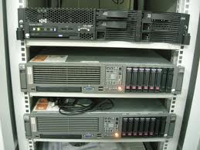
The Operating System Zoo
Server OS
Runs on Server (PC, workstation, or mainframe)
Serves multiple users at once over a network and allow the users to share hardware and software resources
Servers can assume particular task on different server (machine) as web, mail, application, file, firewall, CA – Certificated authentication, etc …
UNIX, Windows NT, Windows 2K (2000, 2003, 2008), Linux, Fedora Core, Ubuntu, Solaris ...

Slide 10
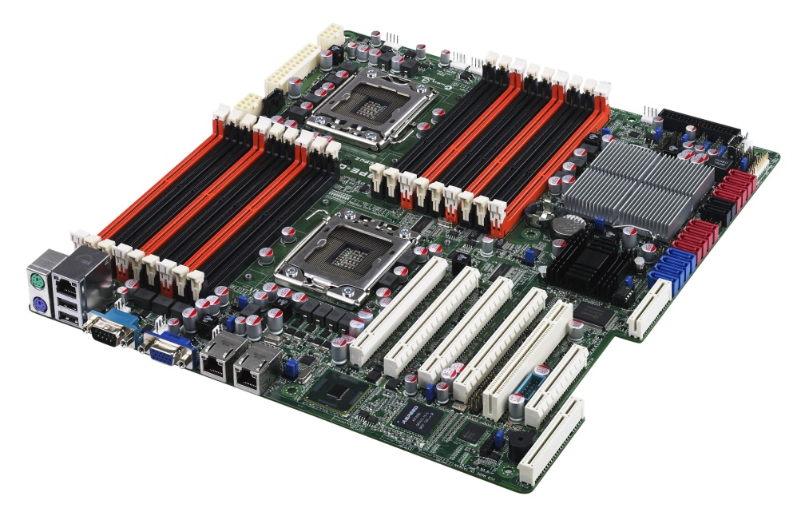
The Operating System Zoo
Multiprocessor OS
Is known parallel systems
Runs on systems that have many CPUs (multi-processors, multi-cores, multi-chips)
Many processors communicate in close, share the computer bus, the clock, and sometimes memory and peripheral devices
Increased throughput
Saving (share peripherals mass storage, …)
Increased reliability (not halt system, sharing the work with other processors)
Windows, Linux, SunOS (Solaris), UNIX, OS/2 …

Slide 11
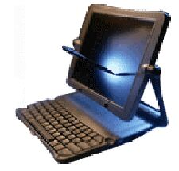
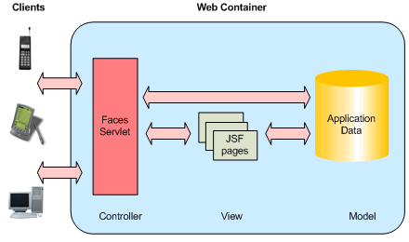
The Operating System Zoo
Personal Computer OS
Supports multiprogramming
Good supports to a single user (thus, it has become popular nowadays)
Optimizes for maximizing user convenience and responsiveness
Are used for word processing, spreadsheets, Internet access …
Windows 98, Windows ME, Windows XP, Windows Vista, Windows 7, Macintosh, Linux, Fedora Core, Ubuntu ...

Slide 12


The Operating System Zoo
Handheld Computer OS
Supports a small computer as handheld or PDA (Personal Digital Assistant), mobile (cellular) phones, smart phones.
Is used with small memory, slow processors, small display screen
Are increasingly sophisticated, with the ability to handle telephony, digital photography, …
Can only run single application
Today, some handheld OS (smart phone) can run multiple program (e.g. Windows Mobile version ≥ 6, Symbian ≥ 7, Mac, Android, iOS, …)
Symbian, Palm, Windows Phone, Windows CE, Android, iOS…
Notes:
Are increasingly sophisticated: ngày càng tinh vi

Slide 13
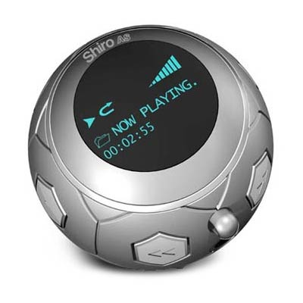
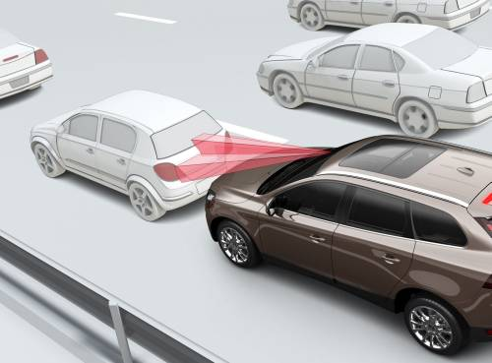
The Operating System Zoo
Embedded OS
Insides electronic devices such as microware ovens, TV, cars, DVD, cellular phones, MP3 player, recorder …
Is tailored for its specific applications
Runs a limited number of programs, known at design time
It may be possible to make optimizations not possible in general purpose systems
There is no need for protection between applications
Is located in ROM
VxWorks, QNX

Slide 14
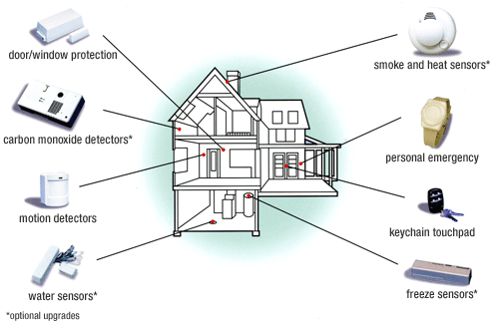
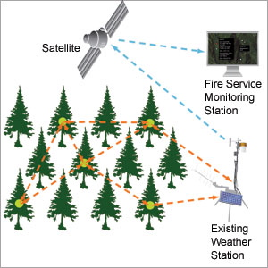
The Operating System Zoo
Sensor Node OS
Supports sensor node
Each sensor node is a real computer with CPU, RAM, ROM, and one or more environmental sensors
Usually one that is event driven, responding to external events or making measurements periodically based on an internal clock
Ex: on camera secure the building, forecast or predict environments (weather, fires, temperatures …)
Small size, using low power
Is dependent on battery
TinyOS

Slide 15
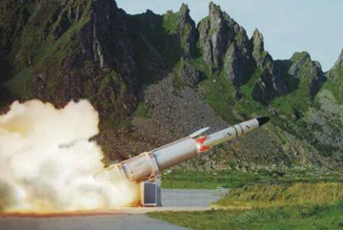
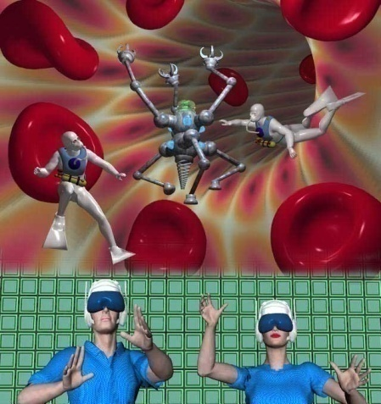

The Operating System Zoo
Real-Time OS
Time is important, and the hard deadlines must be met
Supports real-time system as industrial robots, assembly line, digital telephones
2 types
Hard real-time system: Provides absolute guarantee certain time
Ex: military, avionics, …
Soft real-time system: Can miss deadline (that does not cause permanent damage)
Ex: digital telephones, multimedia systems, real virtual
eCos
Notes:
https://www.highintegritysystems.com/rtos/what-is-an-rtos/

Slide 16
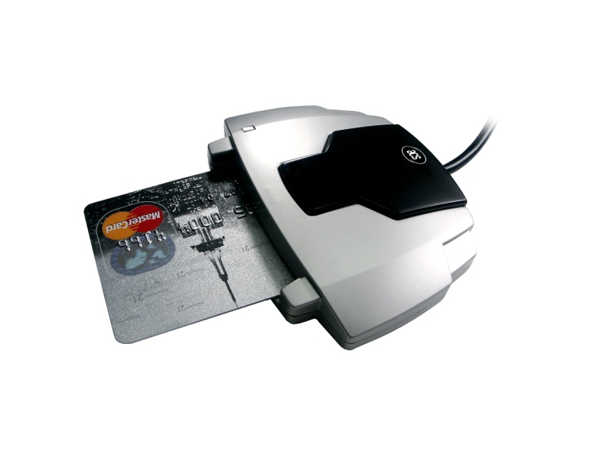
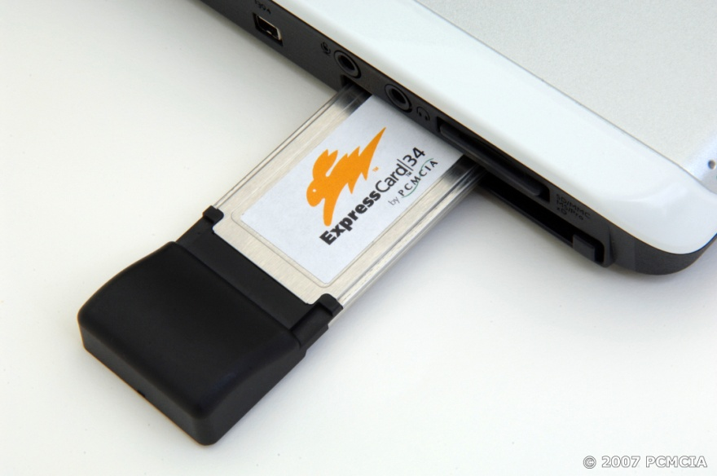
The Operating System Zoo
Smart Card OS
Ex: credit card, ATM, Wireless LAN Card Bus Card, …
Runs on smart cards (with better security and universality)
Have very severe processing power and memory constraints
Can handle electronic payments, presenting Java applets

Slide 17
Introduction Operating System Concepts System Calls

Slide 18
Review
OS
Is a system software
Locates in kernel mode
Efficiently controls and coordinates user interaction with hardware resource
Terminology
Kernel mode, User mode
Latency time
Switch user mode ↔ kernel mode

Slide 19
Objectives
Operating System Concepts
Processes
Address Spaces
Files
I/O
Protection
The Shell
Ontogeny Recapitulates Phylogeny
(evolution of computer hardware and software)
System Calls

Slide 20
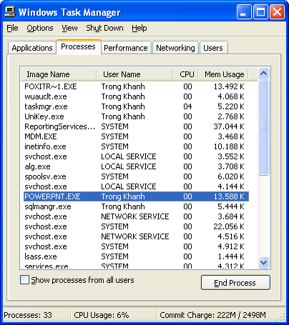
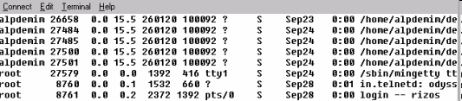
Operating System Concepts Processes
Context
What is the process? When does the process appear on?
Many processes exist at any time, do the many programs run in parallel? How does the OS manage them?

Slide 21
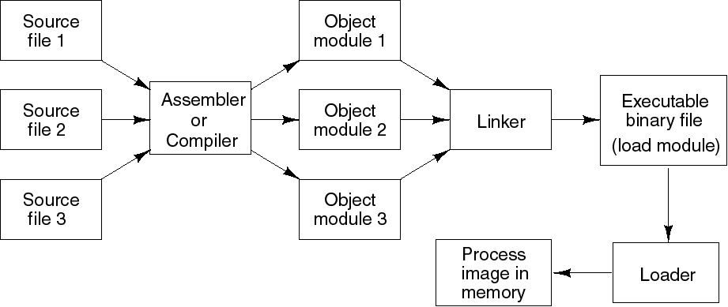
Operating System Concepts Processes
A program in execution
A program loaded into memory and executing
Associated with each process is set of resources such as executable code, data, stack, CPU registers value, PC, and other information needing to run a program
Associated with each process is its address space (i.e., all memory locations that the process can read and write)

Slide 22
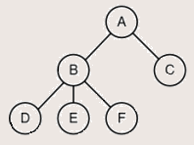
Operating System Concepts Processes
Process table (array or linked list) stores all the information of processes
A system consists of a collection of processes (many programs)
Supporting OS switches the CPU between processes
A process hierarchy (tree)
A process (parent) can create another processes, then the child process can create many processes, forming a process hierarchy
A process has only one parent, but it has zero, one, or more children
A particular OS will implement this concept in different ways
Tanenbaum, Fig. 1-13.

Slide 23
Operating System Concepts Address Spaces
Problems
OS allows multiple programs loaded into memory (multiple processes) at the same time (However, the memory is limited)
→ The system may even pause a running program, swap it out of memory, and later swap it back to somewhere different
→ This can require the developer determined the absolute address of program located in the memory at the time (impossible)
Solutions: Address space is used
Make the different programs think they have the hardware on their own (protection mechanism)
An address spaces is the abstraction that is referenced to the set of addresses for a process
Address space is a list of memory locations (set of addresses) from 0 to some maximum, which the process can read and write (the developer can be flexible in coding)
The address space is decoupled from the physical memory (larger or smaller)

Slide 24
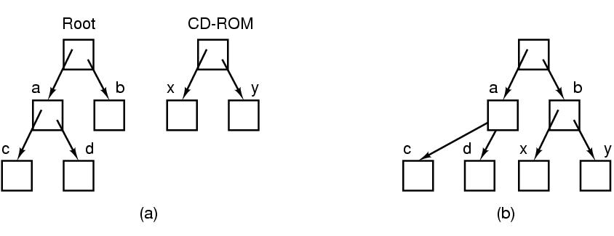
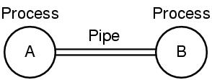
Operating System Concepts Files
Definition
A collection of related information
An abstraction of data stored on HDD
Correlated info
path name, root directory, file descriptor (Windows)
Mounted file system
A pipe (UNIX)
A mechanism for passing data among processes
Is a sort of pseudofile that can be used connect 2 processes
Allows a child process to inherit a communication channel from its parent; data written to one end of the pipe can be read at the other
Tanenbaum, Fig. 1-15 & 16.

Slide 25
Operating System Concepts Files
Definition (cont)
Special file
Make I/O devices look like file that are used for reading or writing
Associates with device driver
2 kinds: block special files and character special files
Block special file
Ex: disks
Is one consisting of sequence of numbered blocks
Each block can be individually (randomly) addressed and accessed
Character special file
Ex: printer, modem, mice, …
Is used for devices that input or output a character stream
Cannot be randomly accessed (not block and not addressed)
Directory
Provide a place to keep files or a way of grouping files together

Slide 26
Operating System Concepts Input/Output
All computers have physical devices for acquiring input and producing output.
Some of them can be shared devices
Others can be dedicated devices
→ How does OS manage/ manipulate I/O (physical) devices?
Every OS has an I/O subsystem for managing its I/O devices
Some of I/O software is device independent
Others are specific to particular I/O devices using device driver
→ OS uses the I/O software based on I/O hardware

Slide 27
Operating System Concepts Protection
Is a mechanism for controlling the access programs, processes, or users of the resources defined by OS
Involves ensuring that all access to system resources is controlled
Protect the code of OS against the processes
Protect one process against other processes
Can improve reliability be detecting latent errors at the interface between component subsystems
OS manage the system security such as
Authentication, protecting the system from unwanted intruders
Give attributes of file to protect the file accession
Notes:
unwanted intruders: kẻ xâm nhập ngoài ý muốn

Slide 28
Operating System Concepts The Shell
Is a piece of software that essentially provides a kind of interface for end-users
Is the UNIX command interpreter (or command-line interface) (Ex: terminal), or GUI (Ex: Gnome, KDE)
Although it is not part of the OS, it makes heavy use of many OS features
Many shells exist such as sh – Shell, csh – C Shell, ksh – Korn Shell, and bash – Bourne Again Shell (default shell in most Linux system)
Functionalities
Is started up (when user logs in) with prompt ($) character
Has the terminal as standard input and output
The shell scripts is a file that contains a list of shell command to be executed in order (same as the bat file in DOS)

Slide 29
Operating System Concepts Ontogeny Recapitulates Phylogeny
Early computers had hardwired instruction sets
The instructions were executed directly by hardware and could not be changed (Not flexible)
Then came microprogramming (faster)
Large Memories
Had just over 128 KB (from 1959 to 1964) using assembly language
Have lots of memory nowadays (up to Gigabytes, Terabytes …)
Protection Hardware
No protection hardware on IBM 7090/7094 so they just ran one program at a time, minicomputer and Intel 8080 – 80286 CPU running multiprogramming
Microcomputer protects hardware and runs ability of multiprogramming at once

Slide 30
Operating System Concepts Ontogeny Recapitulates Phylogeny
Disks
Largely magnetic-tape based (no disks, no file system concepts)
First hard disk (by IBM in 1956) named RAMMAC (4m², store 5 million 7 bit characters, 35.000 $)
CDC 6600 in 1964 (permanent files)
In 1970, the standard disk with 2.5 MB (40cm diameter and 5cm high) had single directory
Floppy disk (512KB, 1.2MB, 1.4 MB …)
Hard disk, Optical, Smart card...
Virtual Memory
Gave the ability to run programs larger than the machine’s physical memory by moving pieces back and forth between RAM and disk
Enabled the ability to have a program dynamically link on a library at run time

Slide 31
System Calls
Context
How do the OS work when we call the fopen and fscanf function to read a text file using C code?
Is the fopen or fscanf function as OS command that can access or control the disk?
Where do both of function operate? Kernel mode or user mode?
Event
A process is running in user mode and needs a system service, it has to execute a trap instruction (interrupt) to transfer control to the OS (kernel mode)
The OS figures out what the calling process wants by inspecting the parameter, then it carries out the system call and returns the control to the instruction following the system call

Slide 32
What’s a System call?
In computing, a system call is the programmatic way in which a computer program requests a service from the kernel of the operating system it is executed on.
System calls provide an essential interface between a process and the OS.

Slide 33
System Calls
The interface between user programs and the OS (hidden to user)
Permit application programs to access protected resources
Making a system call is like making a special of procedure call located in the kernel
Steps in making a system call
Programs put the arguments in registers or on the stack
Then, it issues trap instructions to switch form user mode to kernel mode at the fixed address where the procedure located
The kernel mode dispatches to the correct system call handler
When the system call handler has completed its work, the trap instructions is issued to switch form kernel to user mode
Then, the procedure returns to the user program in the usual way procedure calls return
System calls vs. System Programs
System programs provide a convenient environment for program development and execution (e.g, file manipulation, status, etc…)
System programs define the view of the OS seen by most users
Are simply user interfaces to system call

Slide 34
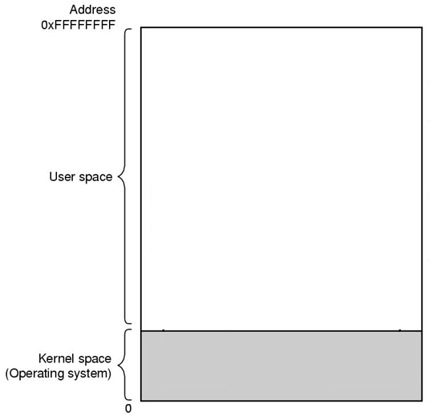
Example
Code Segment
Stack Segment
There are 11 steps executing the system call: read (fd, buffer, nbytes)
Tanenbaum, Fig. 1-17.

Slide 35
Example
Code Segment
Stack Segment
There are 11 steps executing the system call: read (fd, buffer, nbytes)
Tanenbaum, Fig. 1-17.

Slide 36

Example
Code Segment
Stack Segment
There are 11 steps executing the system call: read (fd, buffer, nbytes)
Tanenbaum, Fig. 1-17.

Slide 37

Example
Code Segment
Stack Segment
There are 11 steps executing the system call: read (fd, buffer, nbytes)
Tanenbaum, Fig. 1-17.

Slide 38
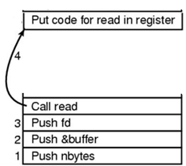
Example
Code Segment
Stack Segment
There are 11 steps executing the system call: read (fd, buffer, nbytes)
Tanenbaum, Fig. 1-17.

Slide 39

Example
Code Segment
5
Stack Segment
6
There are 11 steps executing the system call: read (fd, buffer, nbytes)
Tanenbaum, Fig. 1-17.

Slide 40
Example
Code Segment
5
Stack Segment
9
6
There are 11 steps executing the system call: read (fd, buffer, nbytes)
Tanenbaum, Fig. 1-17.

Slide 41
Example
Code Segment
5
10
Stack Segment
9
6
There are 11 steps executing the system call: read (fd, buffer, nbytes)
Tanenbaum, Fig. 1-17.

Slide 42
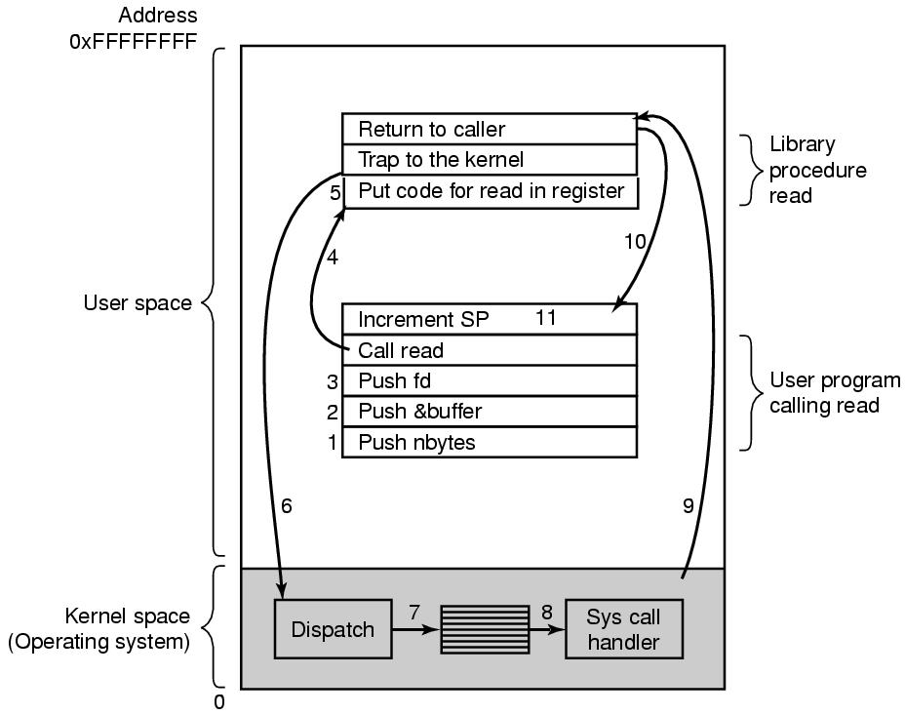
Example
Code Segment
Stack Segment
There are 11 steps executing the system call: read (fd, buffer, nbytes)
Tanenbaum, Fig. 1-17.

Slide 43
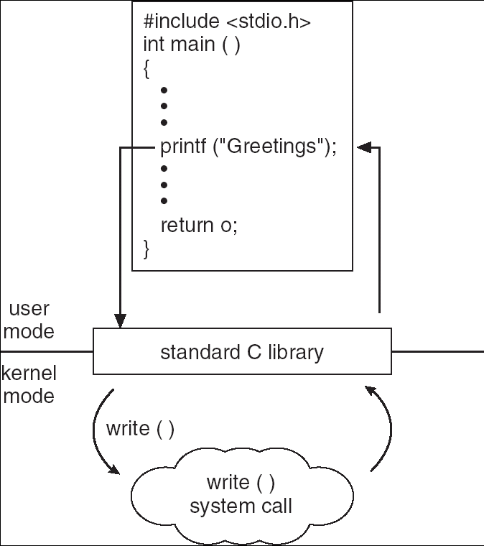
Example

Slide 44
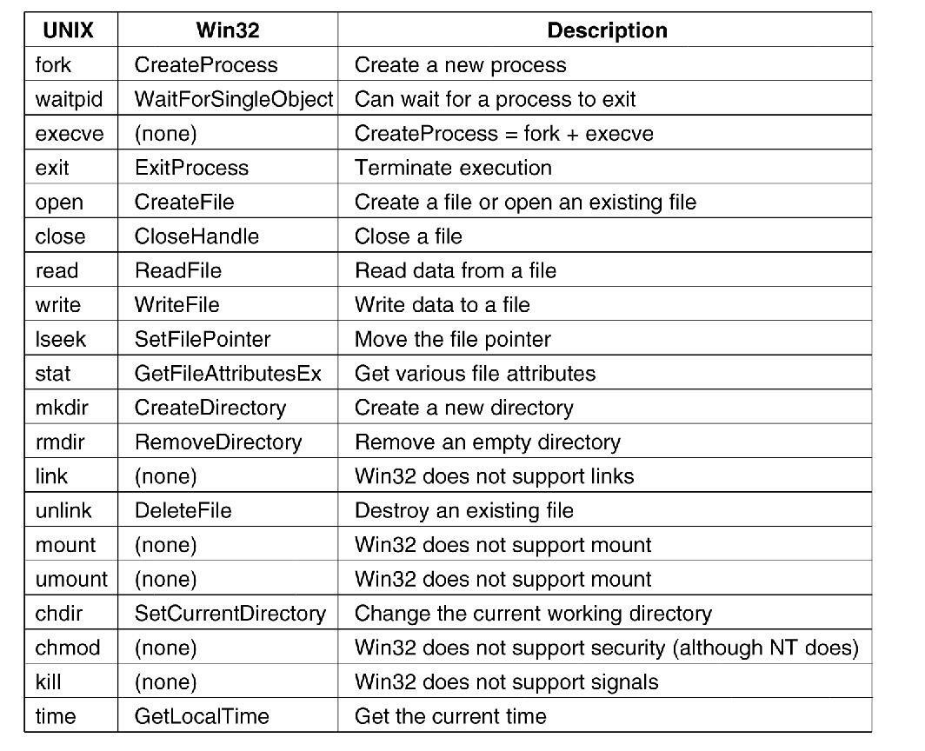
System Calls (cont)
System calls for
Process management: fork(), exec(), wait(), exit() …
File management: open(), close(), read(), write(), lseek(), stat() …
Directory and File system management: mkdir(), mount(), link(), chown() …
Miscellaneous: chdir(), chmod(), kill(), time()
Windows Win32 API
Tanenbaum, Fig. 1-23.

Slide 45
Introduction Operating System Structure

Slide 46
Review
OS
Is a system software
Locates in kernel mode
Manage and make the efficiently and convenient to user about hardware and resource
Terminology
Kernel mode, User mode
Latency time
Switch user mode ↔ kernel mode
Switch CPU a process to other process together
Address space
File Management
File, Directory, Special file (block vs. character)
Pipe
I/O management
Share vs. Dedicated device, I/O software layer (device independent)
System Calls

Slide 47
Review…
Process:
A program in execution
A program loaded into memory and executing
Associated with each process is set of resources such as executable code, data, stack, CPU registers value, PC, and other information needing to run a program
Associated with each process is its address space (i.e., all memory locations that the process can read and write)
Process table (array or linked list) stores all the information of processes
A process hierarchy (tree)
Tanenbaum, Fig. 1-13.

Slide 48
Objectives
OS Structures
Monolithic Systems
Layered Systems
Micro kernels
Client – Server Models
Virtual Machines

Slide 49
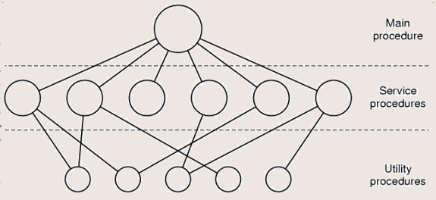
OS Structure Monolithic Systems
The entire OS runs as a single program in kernel mode
The OS is written as a collection of procedures, linked together into a single large executable binary program
A basic structure
A main program that invokes the requested service procedure.
A set of service procedures that carry out the system calls.
For each system call there is one service procedure that takes care of it and executes it
A set of utility procedures that
Help the service procedures.
Do things that are needed by several service procedures (e.g fetch data)
Tanenbaum, Fig. 1-24.

Slide 50
OS Structure Monolithic Systems
Disadvantages
Running a single program
Run only one single large executable binary program (not flexibility)
Do not protection, but hide information
The system is free to call any other ones
Can uses low level language (assembly)
Having thousands of procedure can call each other
Using procedure (static) → cannot manage user environments
Advantages
Simple (fast)
Ex: MS-DOS

Slide 51
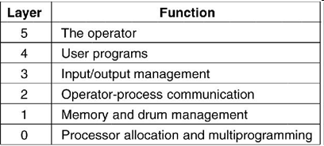
OS Structure Layered Systems
The OS is broken up into a number of layer, each built on top of lower
Assuming that the bottom layer is the hardware, and the highest layer is the user interface, layers are selected so that each one uses functions, operations and services of only lower-level layers.
Lower layers (usually called the kernel) contains the most fundamental functions to manage system resources.
There are 6 layers
Disadvantages
How many layers?
What’re functions?
Slow
Advantages
Easy to maintain, support, manage errors
Modularity, encapsulation
Ex: OS/2, Windows NT, Vista and Unix (describe the system, do not build the system)
Tanenbaum, Fig. 1-25.

Slide 52
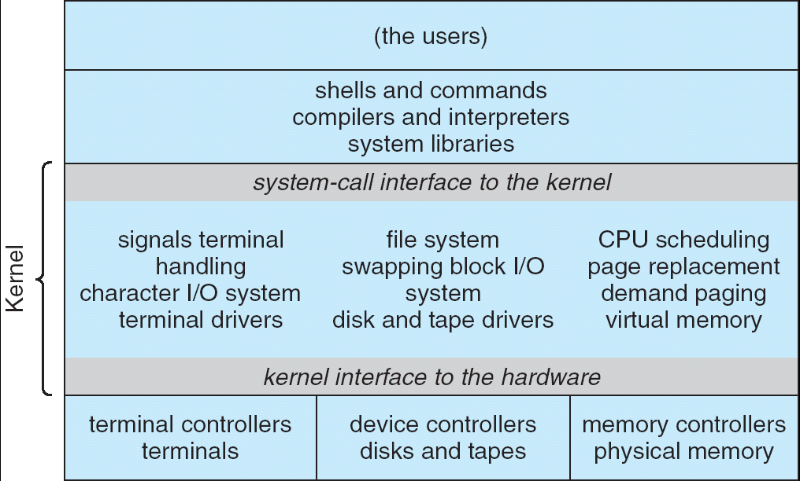
OS Structure Microkernels
OS Kernels have problems
10bugs/ 1000 lines code (buggy, bring down the system)
All the layers went in the kernel (complexity, large, and difficult to manage)

Slide 53
OS Structure Microkernels
Microkernels
Remove all nonessential components from the kernel, and implement them on user mode (splitting the OS into small, well-defined modules)
Running each task as an independent (separate) process → resist crashing the entire system
The modules run user mode → protection against bugs
Making a minimal kernel by put the mechanism for doing something in the kernel but not the policy (scheduling with highest priority process)
Provide a communication facility using message passing between the client program and the various series in user mode
Disadvantages
How to define the components are nonessential or essential? (depending on the design ideas or requirements)
Performance overhead of user space to kernel space communication
Advantages
Easy of extending and port the operating system to new architectures
Advance security and reliability (less code is running in kernel mode)
Ex: Symbian, Apple MacOS X Server

Slide 54
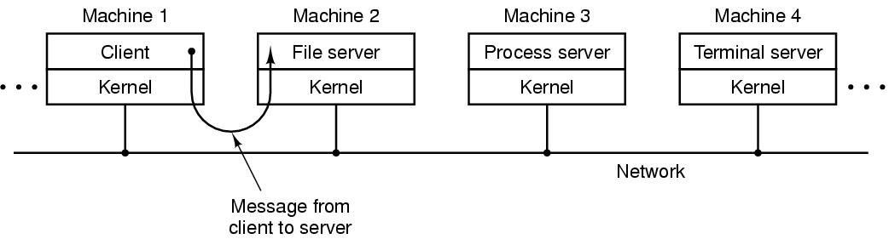
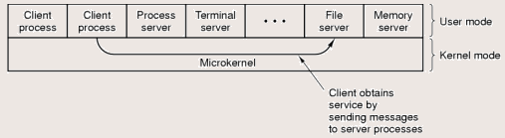
OS Structure Client – Server Model
Server provides some service that satisfy the client’s request
Client uses the server’s services
Message passing is used to communication
Can run on different or same computers
Tanenbaum, Fig. 1-27.

Slide 55
OS Structure Virtual Machines (VM)
Each virtual machine
Are not extended machine
Is identical to the true hardware (provide an exact duplicate of the underlying real machine)
Can run any OS that will run directly on the bare hardware at the same time
Software:
VMware Workstation, MS Virtual PC, Virtual Box, …
OS running on CD (Linux, Ubuntu …)
JVM (Java Virtual Machine):
Java compiler produces code through Java interpreter.
Can be shipped on Internet and run on the computer that has a JVM
Advantages
Completely protecting system resources, solving system compatibility system and do not disrupt the normal system operation
Disadvantages
Can not allocate all disks to VM

Slide 56
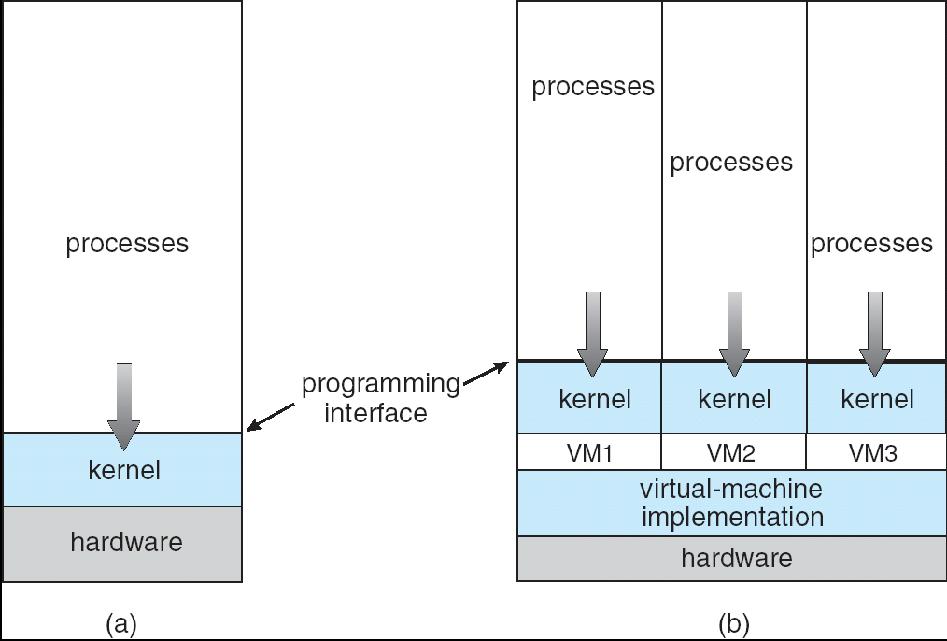
OS Structure Virtual Machines (VM)
(a) Nonvirtual machine (b) virtual machine
Virtual-machine implementation is called virtual machine monitor, or virtualization layer, or hypervisor

Slide 57
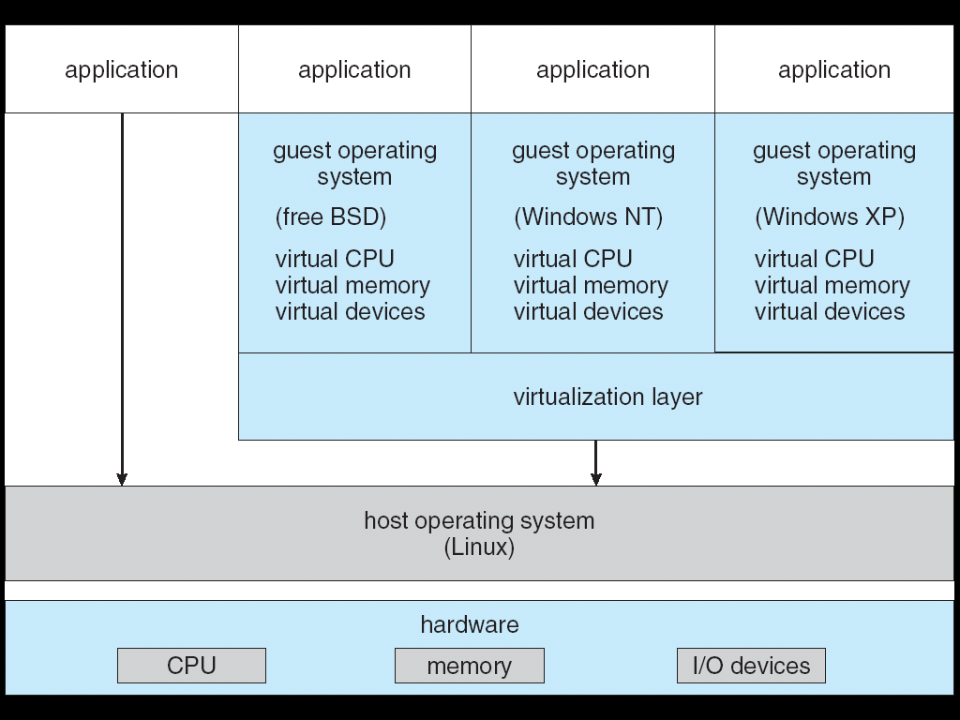
OS Structure Virtual Machines (VM)
VMWare Architecture

Slide 58
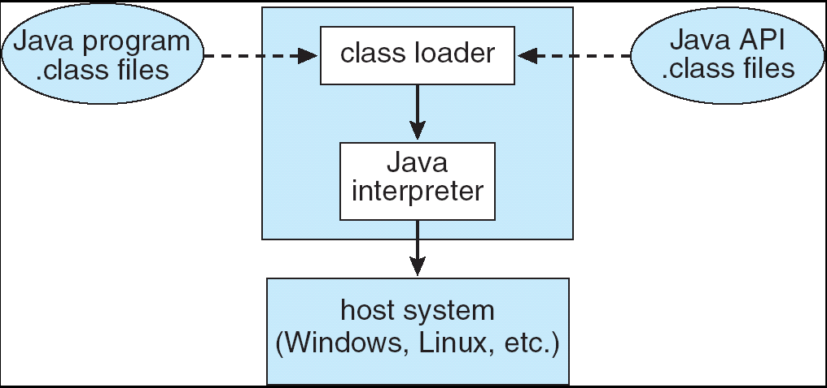
OS Structure Virtual Machines (VM)
JVM

Slide 59
OS Structure Exokernels
Is a program running in kernel mode
Giving each user a subset of the resource (instead of exact copying entire of underlying real machine)
Allocate resources to virtual machines and ensure the protection of them.
Moreover, exokernels make the VM thinking that it has its own disk (0 to maximum size of partition area)
Advantages
The exokernel scheme is saved a layer mapping
Need keep track of which virtual machine has been assigned which resource
Separate the multiprogramming in user mode (protection from real machine)
Less overhead because they keep the VM out of each other’s hair

Slide 60
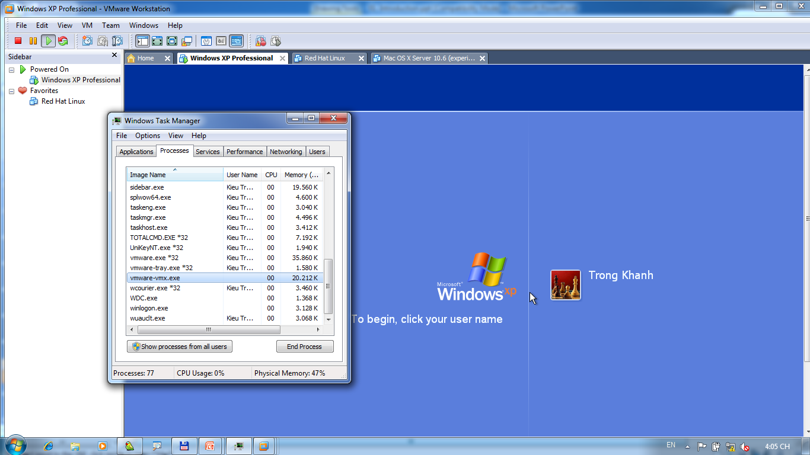
OS Structure Exokernels – Example

Slide 61
Next Lecture
Processes
structure, mechanism, implementation, …
Threads
structure, mechanism, implementation, vs. Processes
IPC
How, comparatives, protection of processes/ threads

